Slide 1
Mobile game (Clash Royale) match result prediction using multiple machine learning algorithms
Zheng Li
Yiming Wang
Fangwen Wu
A CS 446 semester project

Slide 2
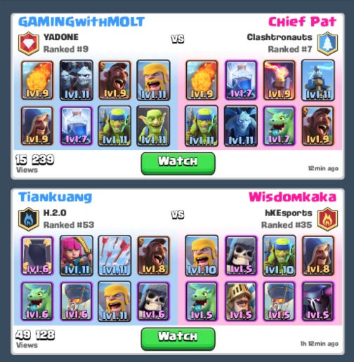

Project Motivation
Clash Royale
Card-based strategy game
Dual players
8 out of 70+ cards
Cards combination

Slide 3
Project Motivation
Clash Royale
Card-based strategy game
Dual players
8 out of 70+ cards
Cards combination
Can we predict the match result given two selected battle decks ?

Slide 4
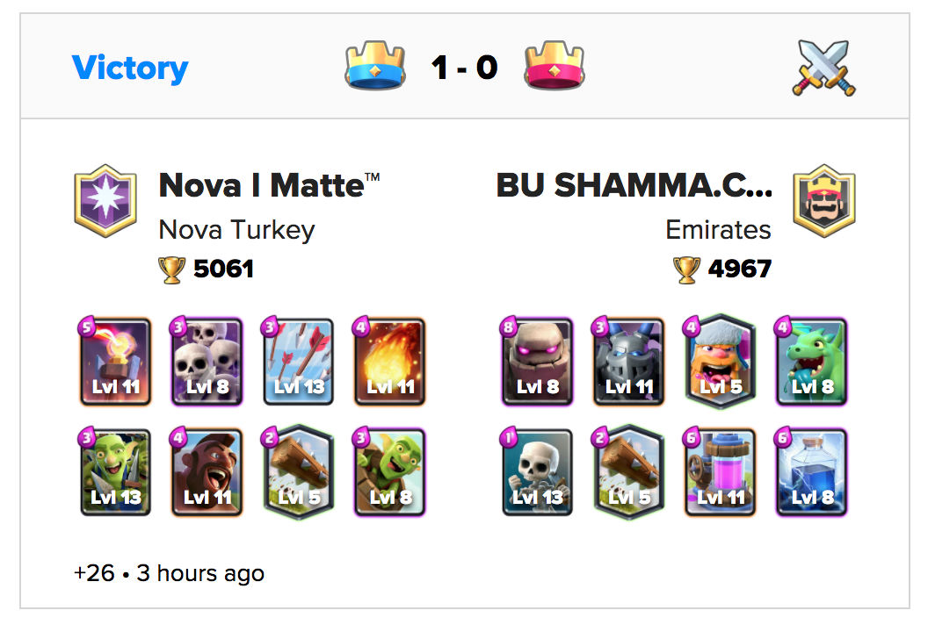
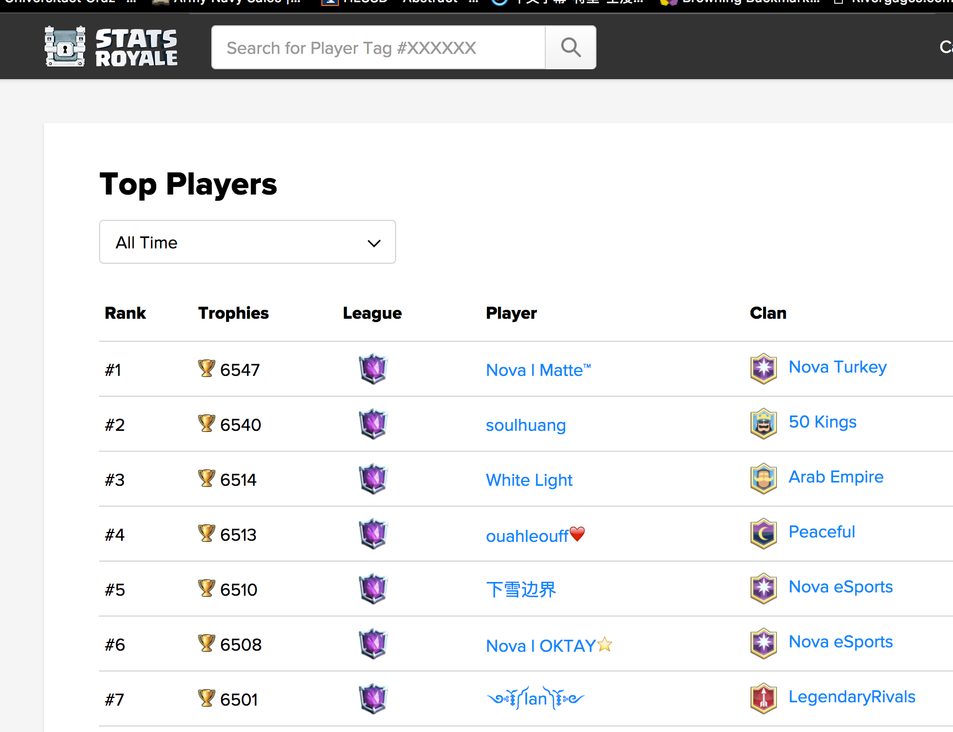
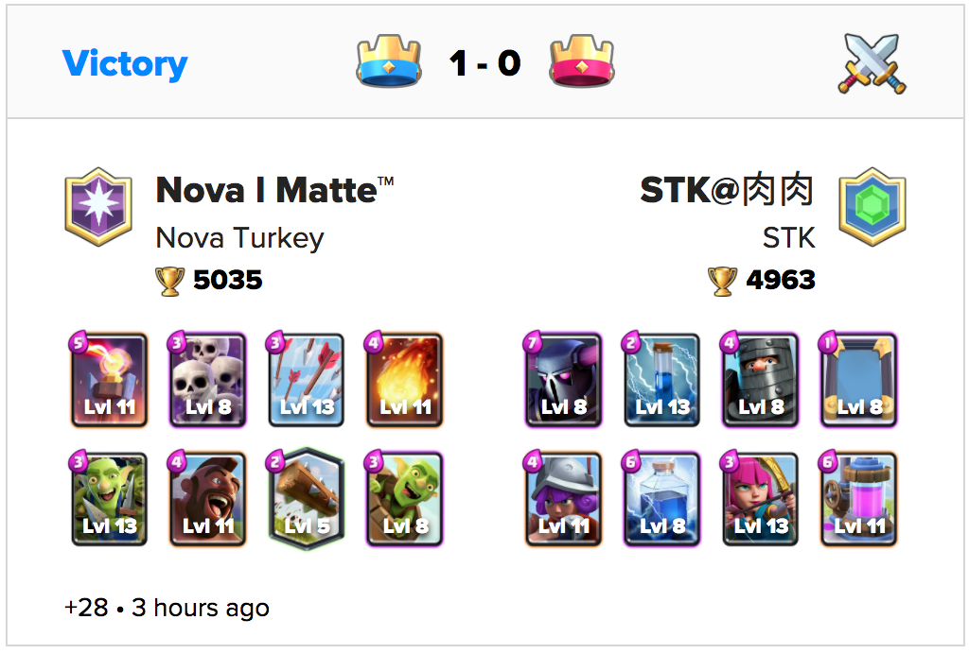
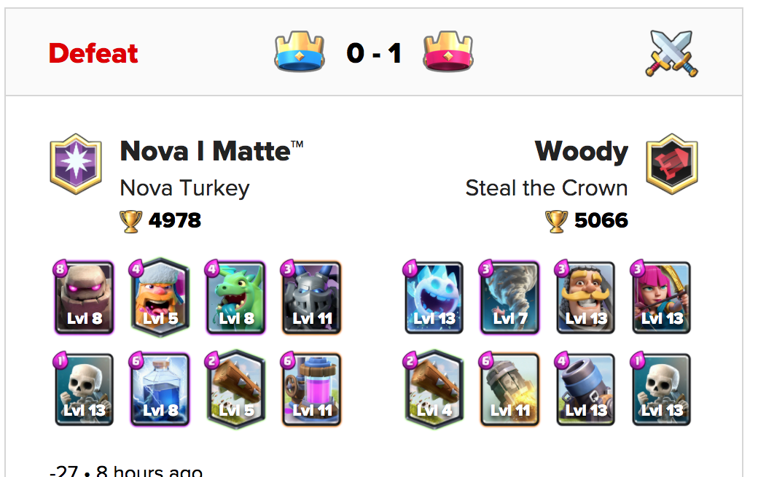
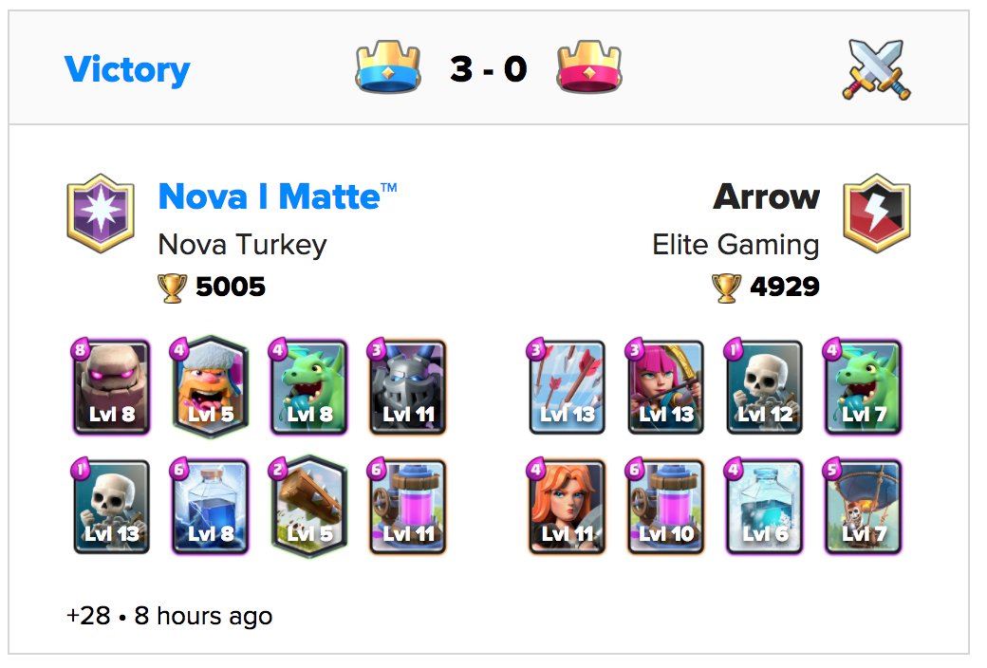
Data Source
Data from StatsRoyale^{[1]}:
Match records from top 1000 players,real-time
[1]: https://statsroyale.com/

Slide 5
Data Source
Data from StatsRoyale^{[1]}:
Match records from top 1000 players,real-time
18,000+ match records
[1]: https://statsroyale.com/

Slide 6
Feature Extraction
Binary feature matrix {1, 0} -- 1,000 columns
Cards composition (has or has not)
Average elixir cost (1,2,3,...,8)
Cards type (Troops, Buildings, Spells)
Cards rarity (Common, Rare, Epic, Legendary)
Cards frequent pattern
Binary label array
Win (1)
Loss (0)
Notes:
We generate feature matrix based on our background knowledge of the game. Features include cards composition, average elixir cost, cards type, etc. We convert this features into binary values. For examples we evaluate has or hasn’t one certain card in the battle deck. Since this is a binary class classification, the label is in binary format.

Slide 7
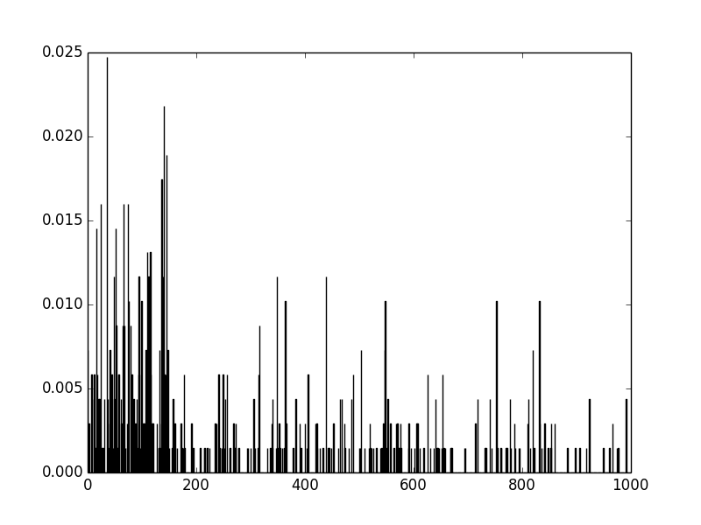
Feature Selection
XGboost Feature Importance Evaluation
Card composition has heaviest weight contribution
Select 150 most important features
Notes:
We have totally about 1000 columns, each corresponding to one feature, this is too large for computation. So we use xgboost feature evaluation tools to reduce dimensions. We plot the weight importance of all features and select 150 most important features. We can see from the plot, cards composition and cards type has average larger weight importance than other kinds of features.

Slide 8
Proposed Algorithms and Results
Algorithm | Accuracy
SVM | 0.6324
Adaboost | 0.6256
Naïve Bayes | 0.5961
Neural Network | 0.5778
Logistic Regression | 0.6279
Random forests | 0.597
AdaBoost over Decision tree | 0.632

Slide 9
Discussion
The 63.2% accuracy is not satisfying due to the
following reasons
Item selection
Amount of data
Game design
Other issues

Slide 10
Future work
Better feature extraction and selection
Extend to multi-class classification
More application extension

